Slide 1
IP Publishing From IP Data Base to IP list to IP catalog
Gabriele Saucier
Design and Reuse

Slide 2
Why is it mandatory? Many facets
IP / Product List on an intranet server or a community server is a key enabler
internal IP management
Synchronized with IP File… catalog of IP (version) with extension ( version ,Configuration)
Corporate meta data exchange( Engineers, Marketing ,Sales ,Delivery ,Finance )
IP Exchange:
What do I deliver to whom? ( Which version on which technology node ,to which client
How do I support ?
IP Web publishing
Web marketing :How do I update my IP list on corporate web site and on public web sites ?
How can I be sure that the IP status on various process node is correctly published?
Need of a centralized List in Sync with IP versions for each facet of the management

Slide 3
D&R IP Management Platform IPMS tm
Java based intranet IP publishing & management platform
IP XML (meta data ) Viewer for all management facets
Flexible evolving (XML) formats with different views ( Designers, Marketing,….)
IP list or IP catalog created by assigning a ( new) format to a catalogue)
Filtered list exportable to other websites
Extended to a set of IP centric product Catalogs (Add ons ,libraries ,drivers, embedded software ..)

Slide 4
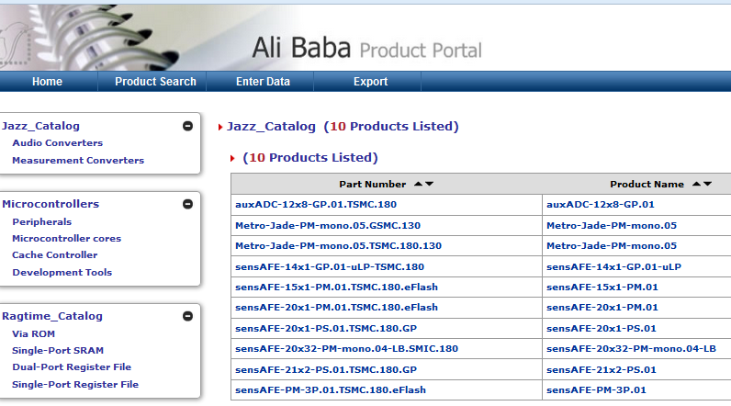
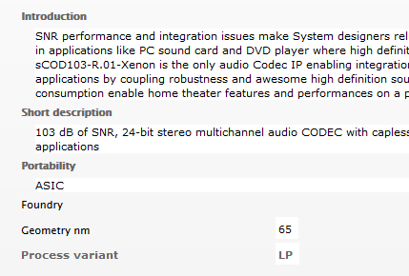
IP Product Catalog
IP provider Meta Data Catalog

Slide 5
Description Format
Library of IP XML description format using a rich extensible set of types
Life cycle support (Map /Bridge to new format)… Extensible search
Title
Text
Date
Attributes
Boolean
Multivalue
Parametric
Links
Hyperlinks
Local File
(Filtered) Link to Panel
Back Annotation
Image
Process Information
Geometry_nm
Foundry
Pre-Silicon
Silicon-Proven
Implemented in Production Designs
Hierarchy
Embedded in
Embedded IP
Add-ons
Where Used( project)
File Management
IP Location Path

Slide 6
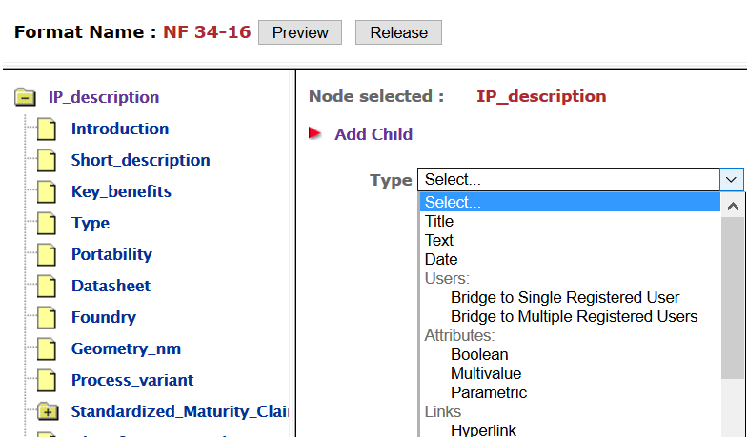
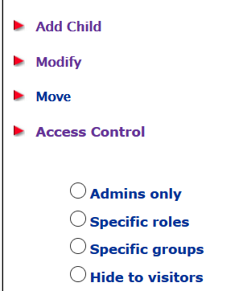
Format Type and Access Control

Slide 7
Required :Comprehensive Publishing Platform
Modular engine: Extensible Toolbox of Java commands grouped into Roles
Admin configures the site
Bridge to authentication system (LDAP, Active Directory)
Access management and Access rights: One shot or permanent to user or groups
Tracking… Mail and Alert Engine… Broadcast… Community forum (Private, Public)
Catalog architect
Catalog creation
Life cycle support
Uploader (Excel fully compatible)
Massive data import Excel upload /Update in one click)
Import/Export over firewall with Filtered data

Slide 8
Application Example D&R Partner IP Private Catalog
For all D&R partner
Hold a private catalog as Entry to D&R portal
Objectives
Control what is published on D&R public websites
Propagate to other sites
Basic publishing techniques
User friendly data entry and update
Unicity of Part Number
Filtered export

Slide 9
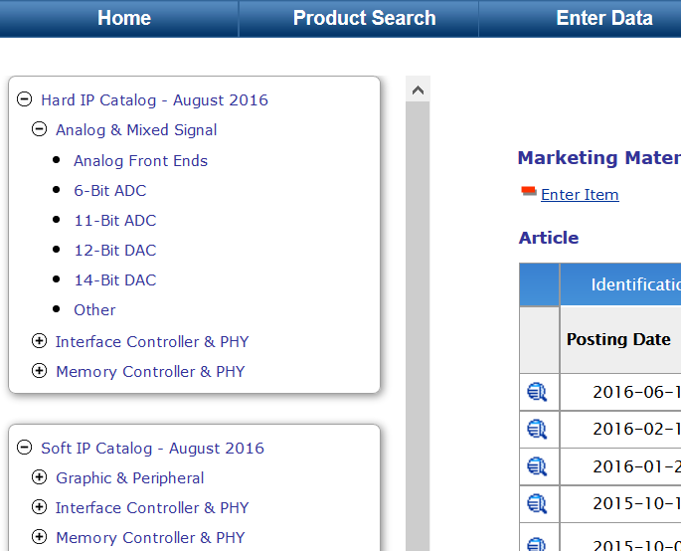
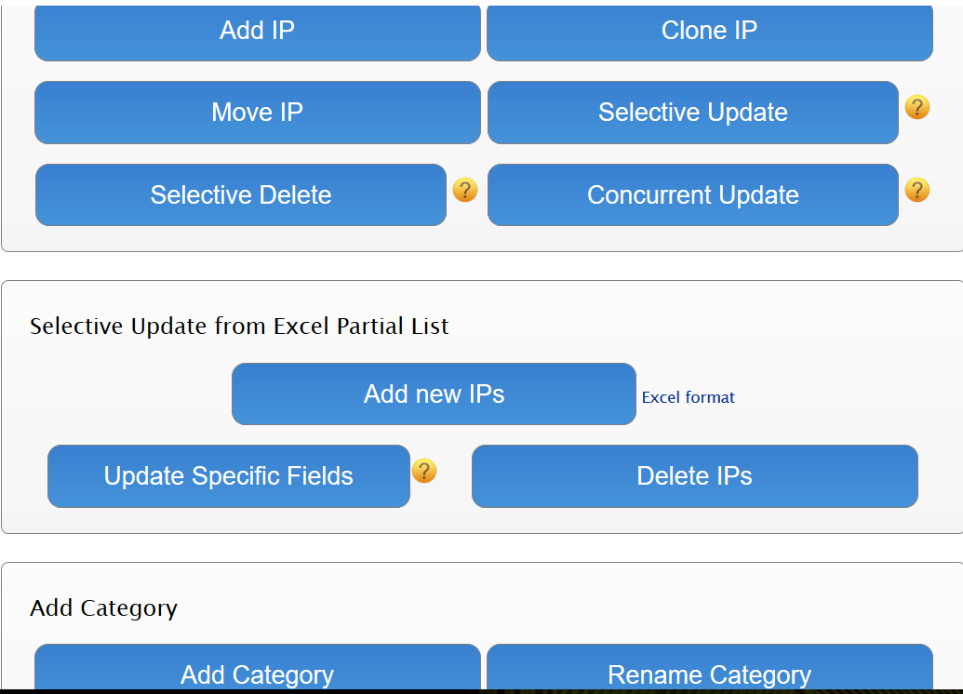
Private Catalog
Friendly Update

Slide 10
Working Session
Green: New IP
Yellow : Modified
Red :Deleted

Slide 11
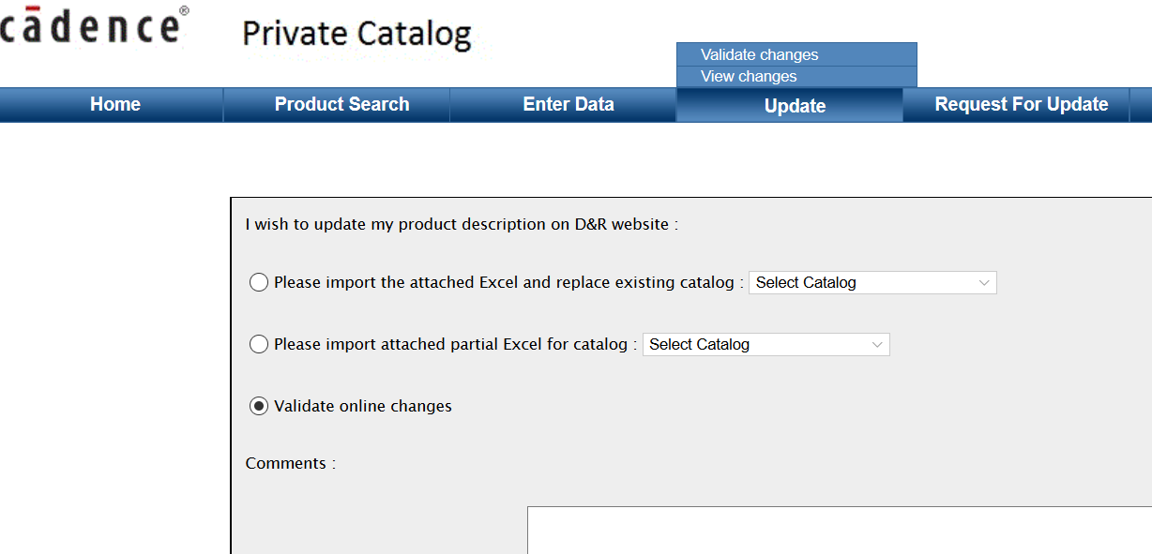
Update Session and Update Request
At any time changes validate
Public website request from session or Excel sheet

Slide 12
Filtered Export

Slide 13
Catalog Extension IP Centric “Management panel”
Concurrent (XML) IP Centric Management Panels
Intelligent Dashboards collecting real time data from multiple DB or sources
Covering as subset all Excel spreadsheet primitives
Extensible to Workflow (states and conditions)
Great Benefit
Get at an glance IP centric key data
The user can follow up the product life cycle (Bug, IP usage, Maturity, Client Delivery, Finance)
Unified IP Data Viewer

Slide 14
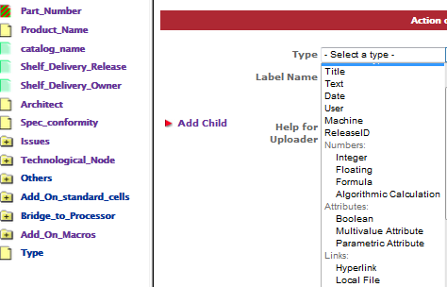
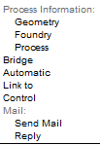
Panel or Dashboard Creation
Similar to catalog format creation: Advanced Types
Python Script
Bridge to external DB
Workflow Control
Call Function
Mail Engine

Slide 15
Connected Synchronized Views
Examples :
Link to panel
Back Annotation in the catalog
Filtered Link
Possibly In Sync with existing Bug DB

Slide 16
Conclusion
IP Publishing is the heart of IP management
Flexible ,exportable web List
Needs to be integrated in a comprehensive web platform
Platform used for various ecosystems
IP Provider gateways
Foundry gateways
FDSOI IP shop
Collaborative consortium project
IoT ecosystem
IPMS intranet/Ecosystem portals technology based on 2 decades of experiences

